Slide 1

CSE (H) with specialization in Machine Learning and Artificial Intelligence
Soft Computing (CSF – 332)
Chapter -2.1
Introduction to Neural Network Models
By: Dr. Monika Singh E11032
DISCOVER . LEARN . EMPOWER

Slide 2
Course Objectives
To introduce soft computing concepts and techniques of artificial neural networks, fuzzy sets, fuzzy logic and genetic algorithms
To understand the various techniques from the application point of view.
To analyze various soft computing techniques and decide the technique to be used in a particular problem situation.
To implement soft computing based solutions for real-world problems

Slide 3
Course Outcomes
CO1 | Identify and describe soft computing techniques and their roles in building intelligent. Machines | 1
CO2 | Recognize the feasibility of applying a soft computing methodology for a particular problem. | 2,4
CO3 | Apply fuzzy logic and reasoning to handle uncertainty and solve engineering problems, genetic algorithms to combinatorial optimization problems and neural networks to pattern classification and regression problems. | 3
CO4 | Effectively use modern software tools to solve real problems using a soft computing approach. | 3
CO5 | Evaluate various soft computing approaches for a given problem. | 4

Slide 4
Table of Contents
Associative Memory Networks
Bidirectional Associative Memory (BAM)
Hopfield Networks
Self-Organizing Feature Maps: Kohonen Self-Organizing Feature Maps.

Slide 5
SELF-ORGANIZING FEATURE MAP
Our brain is dominated by the cerebral cortex, a very complex structure of billions of neurons and hundreds of billions of synapses. The cortex includes areas that are responsible for different human activities (motor, visual, auditory, etc.) and associated with different sensory inputs. One can say that each sensory input is mapped into a corresponding area of the cerebral cortex. The cortex is a self organizing computational map in the human brain.

Slide 6
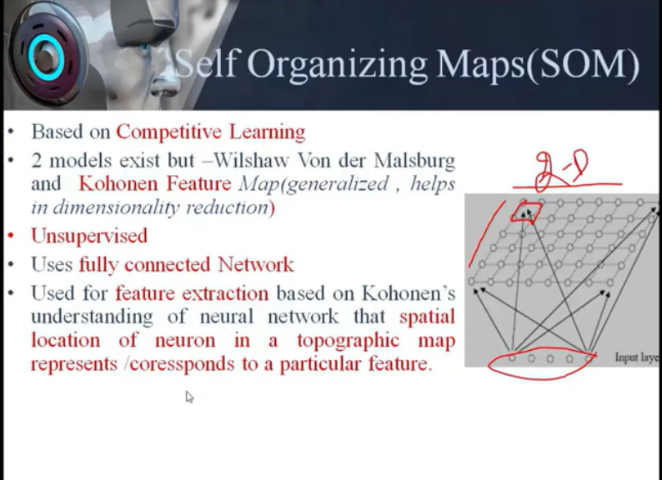

Slide 7
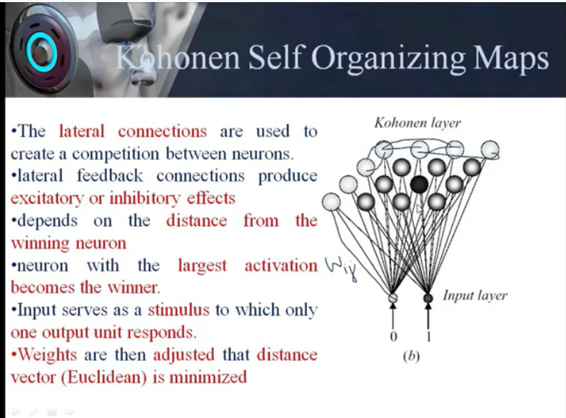

Slide 8
SELF-ORGANIZING NETWORKS
Discover significant patterns or features in the input data.
Discovery is done without a teacher.
Synaptic weights are changed according to local rules.
The changes affect a neuron’s immediate environment until a final configuration develops.

Slide 9
KOHONEN SELF-ORGANIZING FEATURE MAP (KSOFM)
The Kohonen model provides a topological mapping.
It places a fixed number of input patterns from the input layer into a higher dimensional output or Kohonen layer.
Training in the Kohonen network begins with the winner’s neighborhood of a fairly large size. Then, as training proceeds, the neighborhood size gradually decreases.
Kohonen SOMs result from the synergy of three basic processes
Competition,
Cooperation,
Adaptation.

Slide 10
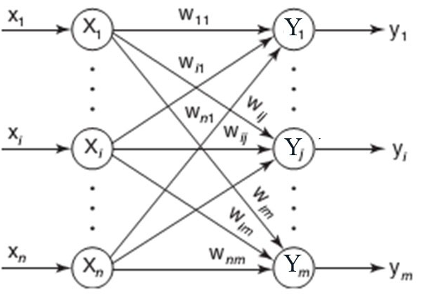
ARCHITECTURE OF KSOFM

Slide 11
CO-OPERATION OF KSOFM
The activation of the winning neuron is spread to neurons in its immediate neighborhood.
This allows topologically close neurons to become sensitive to similar patterns.
The winner’s neighborhood is determined on the lattice topology.
The size of the neighborhood is initially large, but shrinks over time.
An initially large neighborhood promotes a topology-preserving mapping.
Smaller neighborhoods allow neurons to specialize in the latter stages of training.

Slide 12
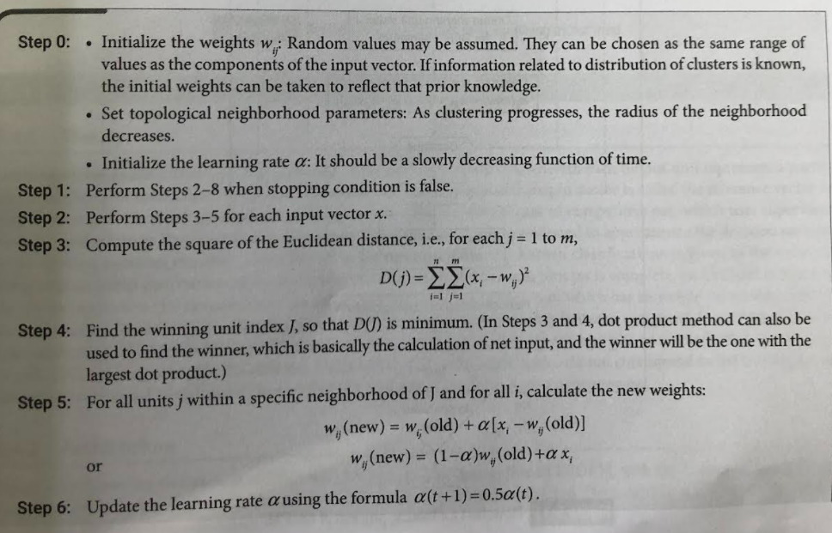
KSOFM Algorithm

Slide 13
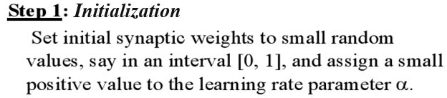
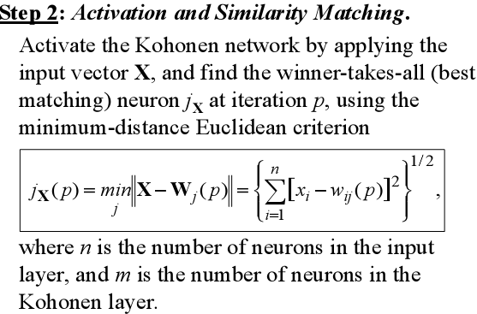
KSOFM Algorithm

Slide 14
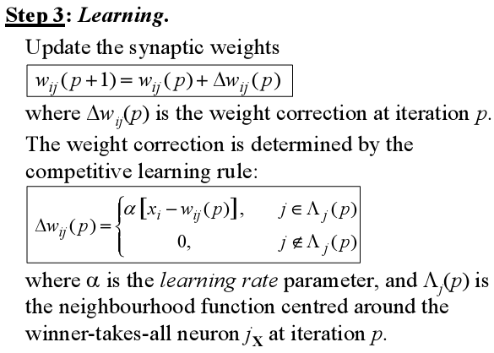
KSOFM Algorithm

Slide 15
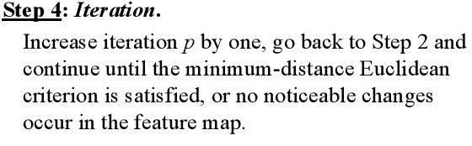
KSOFM Algorithm

Slide 19
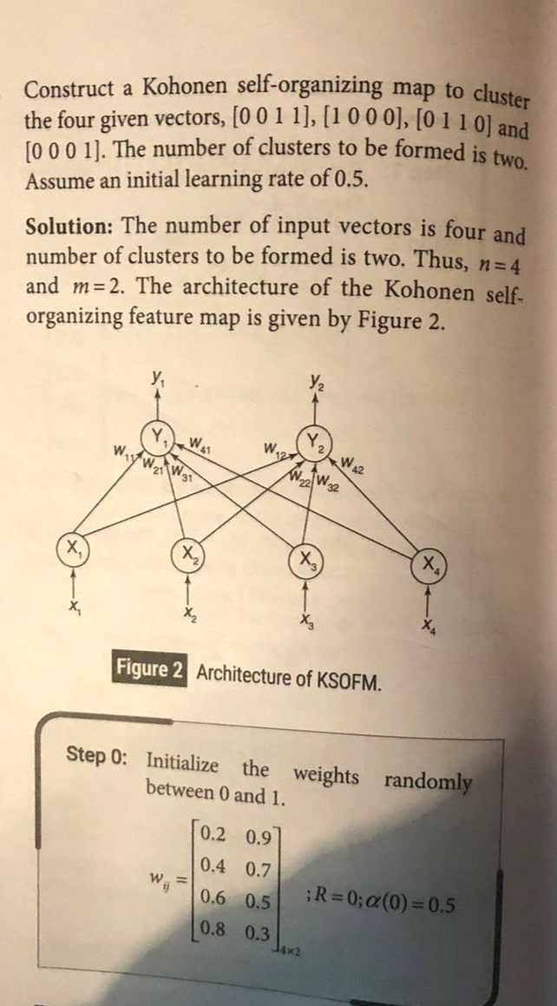

Slide 20
References
“Principles of Soft Computing, 2nd Edition” by S.N. Sivanandam & SN Deepa, Wiley India Pvt. Ltd.
Link :
https://analyticsindiamag.com/6-types-of-artificial-neural-networks-currently-being-used-in-todays-technology/
3. Link for understanding Kohonen Map :
https://www.youtube.com/watch?v=9ZhwKv_bUx8

Slide 21
THANK YOU
For queries
Email: monika.e11032@cumail.in

